Slide 1
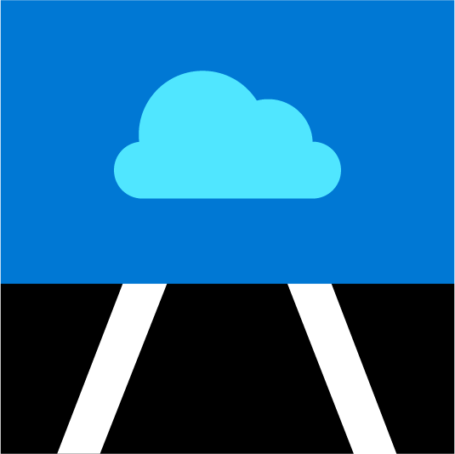
#AzureSQL
Networking, Azure SQL Database, and Private Link:
what you need to know
Anna Hoffman, Data & Applied Scientist / PM
Microsoft Azure Data
January 2021
Notes:
Anna leads, introduces herself and asks Bob to introduce himself
LAYOUT : 2 Person Demo

Slide 2

Azure SQL Fundamentals
Module 1 Introduction to Azure SQL
Module 2 Deploy and configure
Module 3 Security
Module 4
Performance
Module 5
Availability
Module 6
Putting it all together
aka.ms/azuresqlfundamentals
aka.ms/azuresql4beginners
Notes:
Anna to ask Bob about the modules, Bob to explain
Show how to get it setup on Microsoft Learn
Schedule (6.5 hours total)

Slide 3



Azure SQL
A unified SQL portfolio built on the industry-leading SQL Server engine
SQL Server on Azure Virtual Machines
Azure SQL Managed Instance
Azure SQL Database
Best for re-hosting and apps requiring OS-level access and control
Automated manageability features and OS-level access
Best for modernizing existing apps
Offers high compatibility with SQL Server and native VNET support
Best for building new apps in the cloud
Pre-provisioned or serverless compute and Hyperscale storage to meet demanding workload requirements
Infrastructure as a Service
Platform as a Service
Overview
Connectivity
Network security
Recommendation
Summary
Notes:
Emily

Slide 4
SQL connectivity architecture
WEST US
23.99.34.75
mysqldbsrv.database.windows.net
GW
GW
westus1-a.control.database.windows.net
104.42.238.205,1433
104.42.238.205
GW
GW
proxy
GW
(1) redirect-find-db
GW
GW
(2) redirect-query
..westus1-a.worker.database.windows.net
13.123.237.158, [11000 -11999]
Overview
Connectivity
Network security
Recommendation
Summary
Notes:
Anna
LAYOUT : 2 person Desktop TR. Next slide goes to Desktop Only
https://docs.microsoft.com/en-us/azure/sql-database/sql-database-connectivity-architecture
Key points:
Explain from perspective of a client connection
Proxy/Redirect are server level settings apply to all databases
Clients need specific connectivity for Redirect to work – port range plus all Azure Ips in a region

Slide 5
Demo Proxy vs Redirect
Notes:
LAYOUT : 2 Person Demo -> Presenter 1 Desktop
Anna

Slide 6
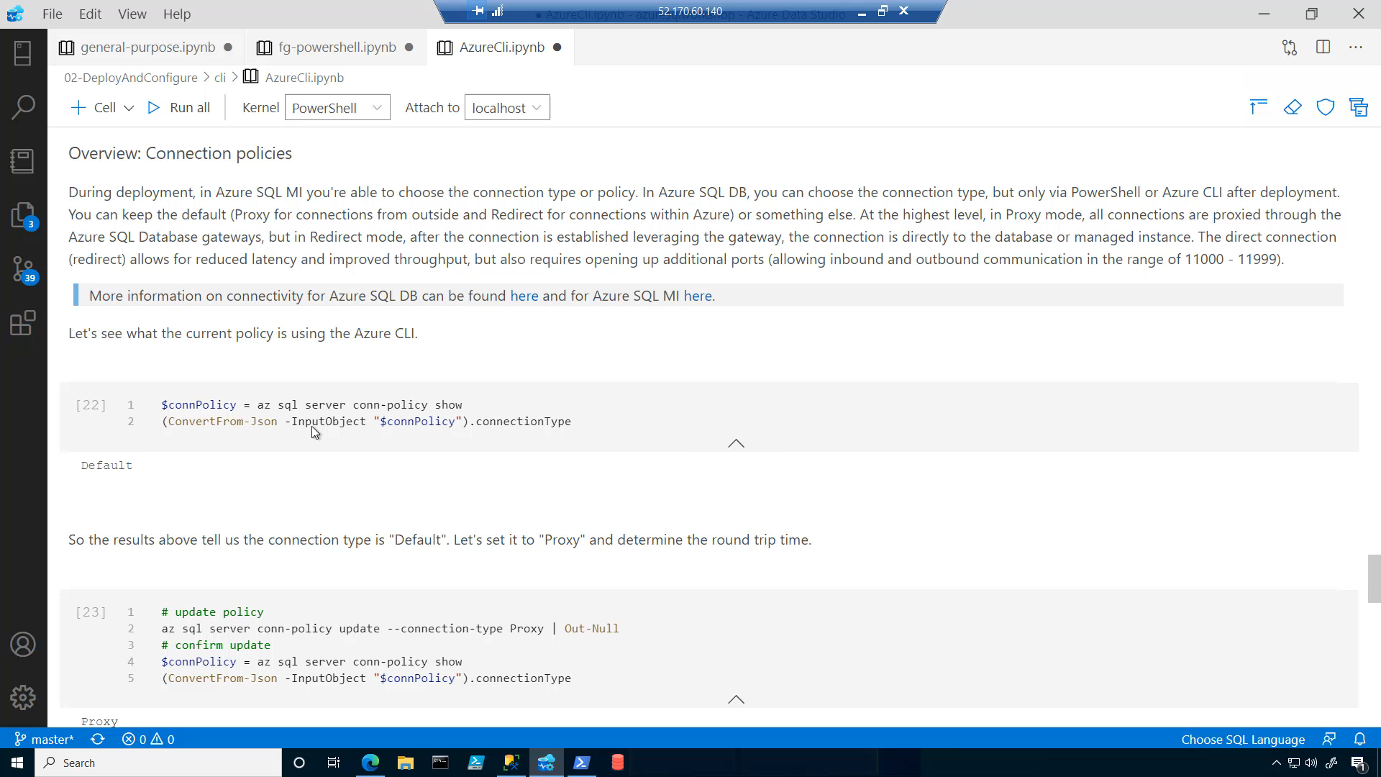

Slide 7
Demo Proxy vs Redirect
Notes:
LAYOUT : 2 Person Demo -> Presenter 1 Desktop
Anna

Slide 8
Knowledge check
What is the default connection policy for Azure SQL Database?
A. Proxy for all connections
B. Redirect for all connections
C. Proxy for connections within Azure and
Redirect for connections outside of Azure
D. Proxy for connection outside of Azure and
Redirect for connections within Azure
Notes:
NOTE – put both on same page
LAYOUT : 2 Person Demo. Next slide goes to 2 Person Desktop TR
Redirect can be used by default because the ports needed are open within Azure.

Slide 9
Network security – SQL Database
Allow access to Azure services
VMVNET-EUS
VNET Peering
Firewall Rules
US EAST
No access to Internet
SQLDBVNET-EUS
Virtual Network Rules
US EAST
Private Link
Azure VM
10.0.0.3
127.33.201.5
VMVNET-WUS
Azure VM
174.17.218.16
US WEST
10.0.0.2
10.0.0.5
mysqldbsrv.database.windows.net
Private Endpoint
westus1-a.control.
database.windows.net
104.42.238.205
mysqldbsrv.privatelink.
database.windows.net
10.0.0.5
Azure VM
102.14.157.9
10.0.0.1
VNET Gateway
VNET Gateway
Vnet2Vnet
P2S, S2S VPN Express Route
On-premises
Overview
Connectivity
Network security
Recommendation
Summary
Notes:
LAYOUT : 2 Person Desktop TR
Anna
Private link:
Benefits:
Private endpoint for Azure SQL (server level)
On-premises connectivity via Express Route/VPN
Data exfiltration protection
Can be part of network monitoring strategy using a Network Virtual Appliance (NVA)
Currently in GA for:
Azure SQL Database (singleton databases)
Azure SQL Data Warehouse
Azure Storage

Slide 10
Demo Network security for Azure SQL Database
Notes:
LAYOUT : 2 Person Demo -> Presenter 1 Desktop
Anna

Slide 11
Network security – SQL Managed Instance
VMVNET-EUS
VNET Peering
SQLDBVNET-EUS
US EAST
US EAST
Azure VM
10.0.0.3
127.33.201.5
sql-mi-2.25984.database.windows.net
Azure VM
10.0.0.254
174.17.218.16
10.0.0.5
10.0.0.2
US WEST
sql-mi-1.259fs.database.windows.net
Private Endpoint
10.0.0.252
Azure VM
MI Subnet
102.14.157.9
10.0.0.1
VNET Gateway
VNET Gateway
On-premises
Vnet2Vnet
P2S, S2S VPN Express Route
Overview
Connectivity
Network security
Recommendation
Summary
Notes:
LAYOUT : 2 Person Desktop TR
Anna

Slide 12
Setup and configure network security
Azure SQL Database
Azure SQL Managed Instance
Configure Private Link if possible
Not possible?
Configure virtual network and subnet before or during deployment
Follow standard networking practices to enable connectivity
Deny public network access
Set Allow Access to Azure services OFF
Configure Firewall rules
Configure Virtual Network rules
Overview
Connectivity
Network security
Recommendations
Summary
Notes:
LAYOUT : 2 Person Desktop TR
Bob
https://docs.microsoft.com/en-us/azure/cloud-adoption-framework/reference/networking-vdc
https://docs.microsoft.com/en-us/azure/cloud-adoption-framework/reference/vdc

Slide 13
Knowledge check
Consider the example from the unit where the Azure VM public IP address is 174.17.218.16 and the Azure VM private IP address is 10.0.0.2.
When using virtual network rules to configure network access to Azure SQL Database, what will be returned from:
SELECT client_net_address
FROM sys.dm_exec_connections WHERE session_id=@@SPID;
A. 174.17.218.16
B. 10.0.0.2
C. Both IP addresses
D. Neither IP address
What is the recommended way to protect your network for Azure SQL Database?
A. Allow access to Azure services
B. Firewall rules
C. Virtual network rules
D. Private Link
Notes:
NOTE – put both on same page
LAYOUT : 2 Person Demo
This will create a DNS hierarchy without information related to the Azure SQL Database logical server, and a truly private endpoint.
This will be returned if virtual network rules or Private Endpoint(s) are enabled.

Slide 14



Incoming Connection
Deny Public Network Access
Yes
No
Match found in VNET firewall rules?
Yes ( server scoped, {DB1,DB2})
No
Connect via
Private Endpoint
Database Level Firewall
Server scoped, {DB1,DB2}
myserver.database.windows.net
Yes ( database scoped, DB1 only)
Match found in sys.database_firewall_rules?
DB1
No
Server Level Firewall
Yes ( server scoped, {DB1,DB2})
Match found in sys. firewall_rules?
No
DB2
Connection Denied
Overview
Connectivity
Network security
Recommendations
Summary
Notes:
https://docs.microsoft.com/en-us/azure/sql-database/sql-database-firewall-configure

Slide 15
Resources
Try the Azure SQL Workshop
aka.ms/sqlworkshops
Microsoft Learn: Azure SQL Fundamentals
aka.ms/azuresqlfundamentals
Azure SQL documentation
aka.ms/azuresqldocs
More videos from our team
aka.ms/azuresql4beginners
aka.ms/dataexposed
This deck:
AKA.MS/ANNALYTICS
#AzureSQL @AzureSQL @AnalyticAnna
Overview
Connectivity
Network security
Recommendations
Summary
Notes:
Anna

Slide 16
More resources
YouTube playlist of videos: https://www.youtube.com/playlist?list=PL3EZ3A8mHh0xtbf4Cr2yR4-xsUtELwPjw
High level overview of the various network access controls (including Private Link ) https://docs.microsoft.com/en-us/azure/azure-sql/database/network-access-controls-overview
Private Link for SQL Db https://docs.microsoft.com/en-us/azure/azure-sql/database/private-endpoint-overview
SQL Database Connectivity Architecture [ https://docs.microsoft.com/en-us/azure/sql-database/sql-database-connectivity-architecture]
SQL Managed Instance Connectivity Architecture[https://docs.microsoft.com/en-us/azure/sql-database/sql-database-managed-instance-connectivity-architecture]
Connect to Azure SQL Database V12 via Redirection [https://techcommunity.microsoft.com/t5/DataCAT/Connect-to-Azure-SQL-Database-V12-via-Redirection/ba-p/305362]

